Slide 1

BLDEA’s
V P Dr PG Halakatti College of Engineering & Technology
Vijayapura - 586103 Department of Computer Science & Engineering
Presentation on
"Sentiment Analysis in Indian Regional Language -Kannada"
Presented by:
Vaibhav Thobbi (2BL19CS106)
Vineet Girgaonkar (2BL19CS110)
Nikhil Gugawad (2BL19CS057)
Rohit Biradar (2BL19CS075)
Under the guidance of Prof. D. M. Ijeri

Slide 2

Introduction.
Technology and social media platforms have revolutionized communication, with billions of internet users worldwide
Sentiment Analysis is crucial for understanding user opinions on platforms like Twitter, Facebook, and WhatsApp
India's linguistic diversity, including the Kannada language, presents a challenge for sentiment analysis due to limited resources
Sentiment analysis involves analyzing emotions and attitudes expressed in reviews, inquiries, and requests
It has become increasingly important with the rise of internet usage and public opinion exchange
Develop an efficient model for Sentiment Analysis in Kannada language using Natural Language Processing and various classification methods

Slide 3
Literature Survey.
SL. NO | Title | Year | Authors | Methods | Advantages | Drawbacks
1 | Performance Evaluation and Comparison Using Deep Learning Techniques in Sentiment Analysis | 2021 | A. Pasumpon Pandian | Deep learning techniques | Deep learning techniques can handle complex patterns in sentiment analysis, potentially leading to higher accuracy. | Deep learning models require a large amount of labeled data for training and can be computationally expensive.
2 | Sentiment Analysis on Code-Mixed Dravidian Languages, A Non-Linguistic Approach | 2021 | Prasad A. Joshi and Varsha M. Pathak | Non-linguistic approach | The non-linguistic approach allows for sentiment analysis in code-mixed Dravidian languages, which may have limited linguistic resources. | Non-linguistic approaches may have limitations in capturing fine-grained linguistic nuances and cultural context.
3 | Sentiment Analysis of Indian Regional Languages on Social Media | 2021 | Kakuthota Rakshita, Ramalingam H M, M Pavitra | ,Twitter APIs ,text blob | The study focuses on sentiment analysis of Indian regional languages, which is valuable for understanding sentiment trends in specific regions. | It does not provide features like dependency parsing, word vectors, It is little slower in the comparison to spacy
4 | A Novel Fusion-Based Deep Learning Model for Sentiment Analysis of COVID-19 Tweets | 2021 | Mohammad Ehsan Basiri and Shahla Nemati | Fusion-based deep learning model | The fusion-based deep learning model may integrate multiple data sources or features, potentially improving sentiment analysis accuracy. | The fusion-based approach may require additional preprocessing and feature engineering, making it more complex.

Slide 4
SL. NO | Title | Year | Authors | Methods | Advantages | Drawbacks
5 | Sentiment Analysis of Multilingual Tweets Based on Natural Language Processing (NLP) | 2021 | Abhijit Bera and Mrinal Kanti Ghose | SNN,CNN,LSTM | NLP-based sentiment analysis can leverage linguistic features and techniques to capture sentiment in multilingual tweets. | The accuracy of NLP-based sentiment analysis may be influenced by language-specific challenges and the availability of linguistic resources.
6 | Improved Sentiment Analysis for Dravidian Language Kannada Using Decision Tree Algorithm with Efficient Data Dictionary | 2021 | Ranjitha P and Bhanu K N | Decision tree algorithm with an efficient data dictionary | The decision tree algorithm with an efficient data dictionary can improve sentiment analysis for the Kannada language by capturing relevant features and reducing computational complexity. | The effectiveness of the decision tree algorithm heavily depends on the quality and representativeness of the training data.
7 | Sentiment Analysis for Twitter Data in the Hindi Language | 2021 | Anjum Madan and Udayan Ghose | Lexicon Based Approach (LBA) and Machine Learning Approach (MLA) | The study focuses on sentiment analysis specifically for Twitter data in the Hindi language, providing insights into sentiment trends in Hindi-speaking communities on the platform | Struggles with contextual understanding and handling new or slang terms. Time-consuming to create, and models may suffer from overfitting and generalization issues.
8 | L3CubeMahaSent: A Marathi Tweet-Based Sentiment Analysis Dataset | 2021 | Atharva Kulkarni, Meet Mandhane, and Manali Likhitkar | L3CubeMahaSent | Marathi tweet-based sentiment analysis | struggle with understanding context, sarcasm, irony, or figurative language

Slide 5
SL. NO | Title | Year | Authors | Methods | Advantages | Drawbacks
9 | POS Tagger Model for Kannada Text with CRF++ and Deep Learning Approaches | 2020 | M. Rajani Shree and B. R. Shambhavi | CRF++ and deep learning approaches for POS tagging | The combination of CRF++ and deep learning approaches can enhance the accuracy of POS tagging for Kannada text, | The effectiveness of the POS tagger model depends on the availability of annotated data and the complexity of the linguistic features in Kannada.
10 | Sentiment Analysis of Twitter Data with Respect to General Elections in India | 2020 | Ankita Sharma and Udayan Ghose | Deep learning techniques | focuses on sentiment analysis specifically related to the general elections in India, providing insights into the public sentiment and political discourse during this period. | Disadvantages: Without information on the specific methods used, it's challenging to assess the advantages and disadvantages.
11 | Sentiment analysis for code mixed Indian social media text with distributed representation | 2018 | Shalini K, Bharti Ganesh HB, Anand Kumar M and Soman K P | Distributed representation | Using distributed representation can help capture the semantic meaning of code-mixed Indian social media text, | The effectiveness of the approach may be influenced by the availability of labeled data for training the distributed representation models.
12 | Building Sentiment Analysis Model Using Graphlab | 2017 | Mona Mohamed Nasr and Essam Shaaban | Graphlab | Graphlab can provide a framework for building sentiment analysis models, potentially enabling efficient and scalable processing of large datasets. | The specific advantages and disadvantages of using Graphlab for sentiment analysis may depend on the implementation details and the characteristics of the dataset

Slide 6

Existing Systems.
The existing system focuses solely on discerning positive and negative sentiments, without taking into account other sentiment categories.
The majority of the existing system relied on translating the text into English before performing the classification task.
The sentences processed by the existing system contain a restricted number of words.
The existing systems work with a limited dataset due to resource constraints in the Kannada language, which resulted in a reduced amount of training data available for classification.

Slide 7

Problem Statement.
The proposed system aims to develop a sentiment classification model capable of accurately categorizing sentences or phrases into multiple sentiments, including Sadness, Fear, Anger, and Happiness.

Slide 8

Objectives.
1
To develop a system that classifies Kannada sentences into various sentiment categories, including Sad, Fear, Anger, and Joy.
2
To handle lengthy sentences, typically averaging around 10 words,ensuring a sufficient linguistic context for accurate classification
3
To Improve the model's efficiency by utilizing large training dataset of size 2000 sentences

Slide 9

REQUIREMENT AND SPECIFICATION

Slide 10
Hardware Requirements
Memory : Minimum 1 GB, Recommended 4 GB or above
Ethernet connection OR a wireless adapter
Hard Drive: Minimum 32 GB, Recommended 64 GB or more
Processor: Minimum 1 GHz, Recommended 2GHz or more

Slide 11

Software Requirements
Programming Language: Python 3.9.1
Integrated Development Environment : IDLE/PyCharm 2022.3.2
Library: NLTK
Operating System: Windows 10/ Ubuntu
Web Browser: Google Chrome/Firefox

Slide 12
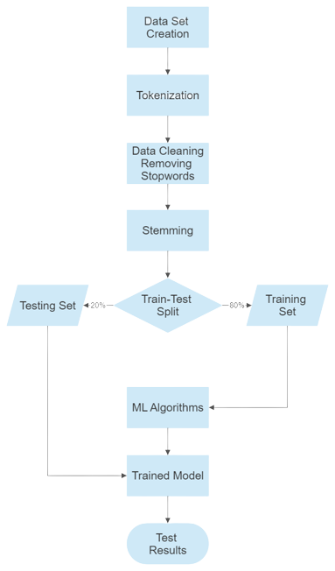
Methodology.
Sentences are extracted from a carefully curated manual dataset
The sentences are tokenized, breaking them down into smaller words for further analysis
Data cleaning techniques are applied to remove unnecessary information from each sentence, including punctuation, commas, and other irrelevant elements
Stop words, such as "ಆದರೆ" and "ಎಂದು," are eliminated from the sentences as they do not contribute to the semantic meaning
The technique of stemming is employed to trace words back to their original form, enhancing linguistic analysis

Slide 13
Contd...
The sentences are then vectorized using TF-IDF vectorizer, representing them numerically for machine learning algorithms
The vectorized sentences are split into training and testing datasets, ensuring unbiased evaluation of the machine learning model
The training dataset is utilized to train the machine learning model, enabling it to learn patterns and sentiments within the Kannada language
The accuracy of the trained machine learning model is evaluated using the testing dataset, providing insights into its performance and generalization capabilities

Slide 14
Data Collection.
About 2000 Kannada phrases were collected from the internet for training the sentiment analysis model
The collected phrases were categorized into four emotions: Joy, Fear, Sadness, and Anger
The data was stored in the XLSX format for convenient handling and organization

Slide 15
Sample Dataset.

Slide 16
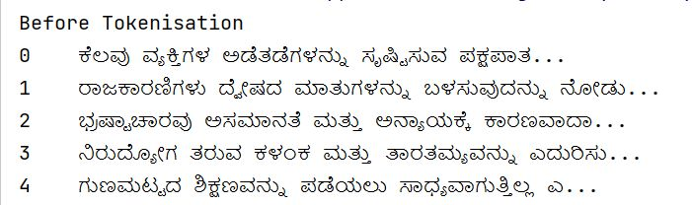
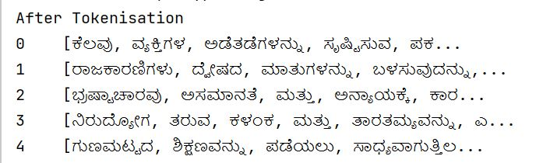
Before Tokenization.
After
Tokenization.

Slide 17
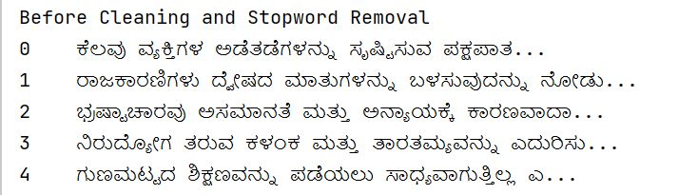
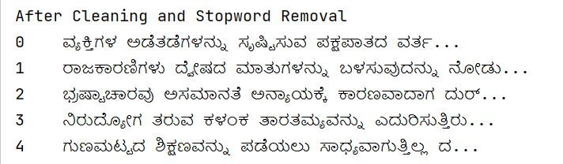
Before Cleaning & Stopwords removal.
After Cleaning & Stopwords removal.

Slide 18
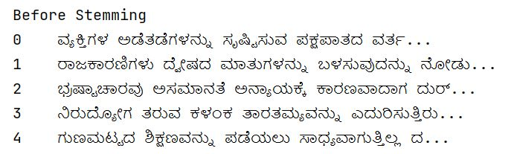
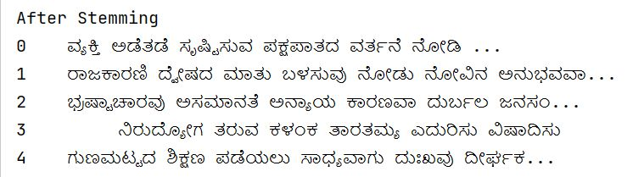
Before Stemming.
After
Stemming.

Slide 19
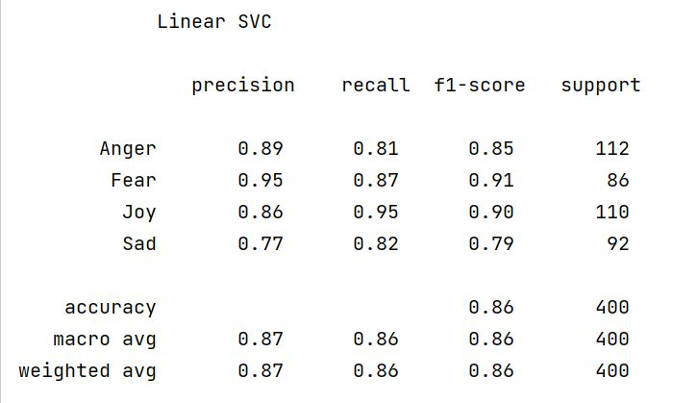
Final Output.

Slide 20
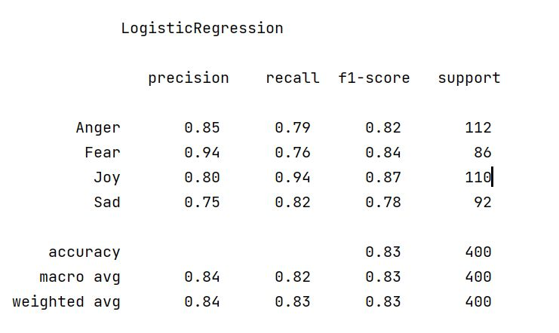
Final Output.

Slide 21
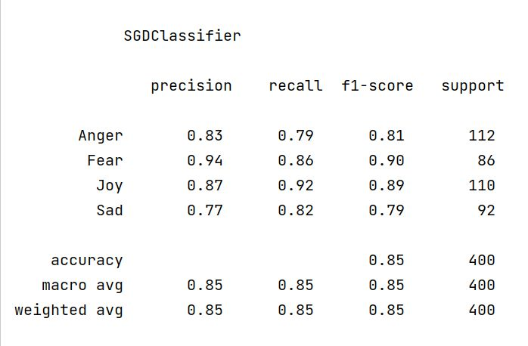
Final Output.

Slide 22
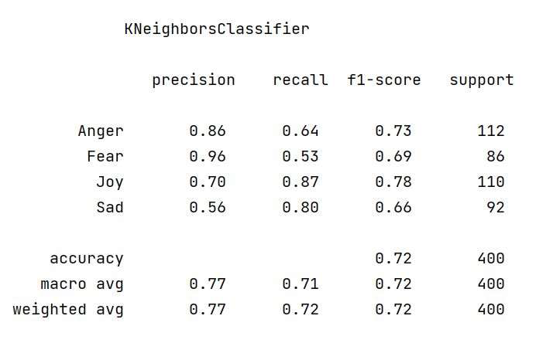
Final Output.

Slide 23
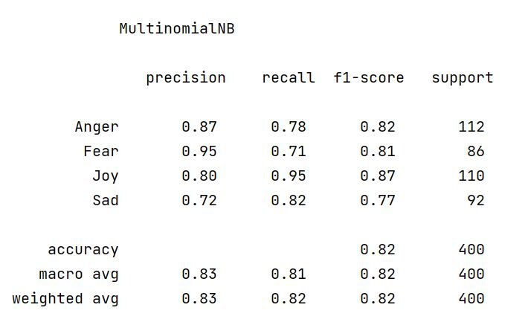
Final Output.

Slide 24
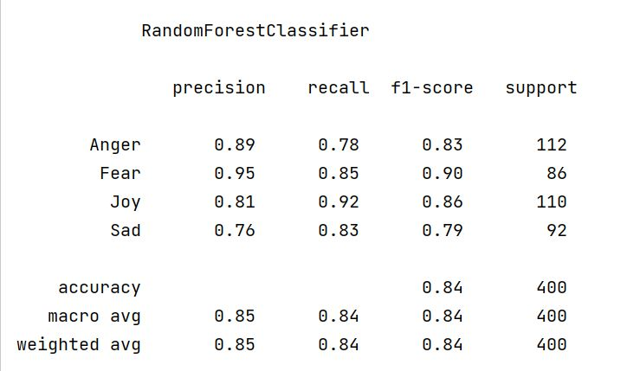
Final Output.

Slide 25
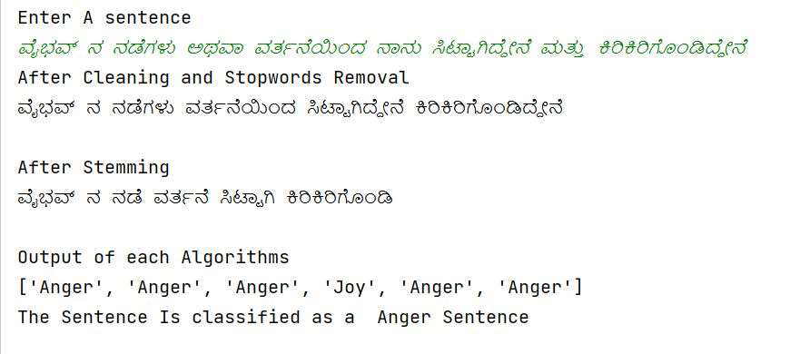
Final Output.

Slide 26
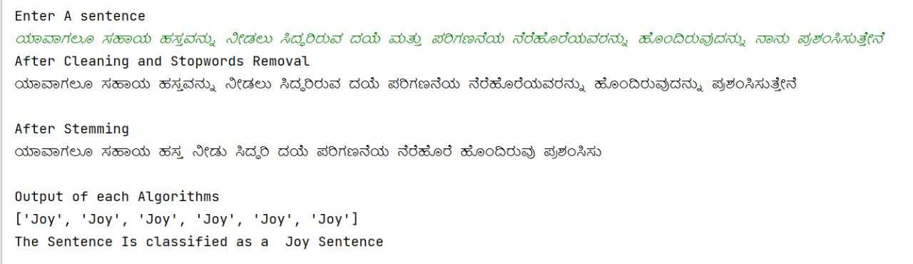
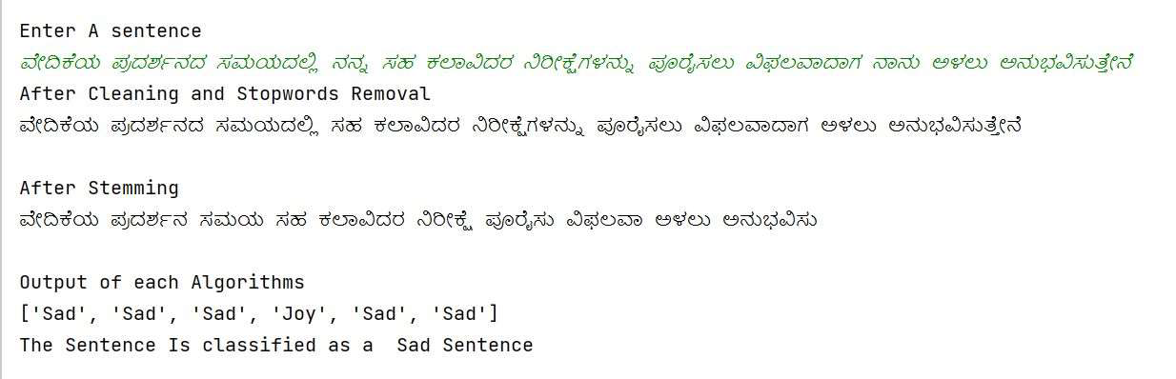
Final Output.

Slide 27

Applications.
Social Media Monitoring
Twitter sentiment analysis enables us to monitor what is being said about the product or service on social media and can assist in identifying irate clients or un-favourable mentions before they become a huge catastrophe.
Customer Service
The objections that were expressed on Twitter can be resolved with the aid of Twitter sentiment analysis. Sixty percent of clients who complain on social media say they want a response within an hour.
Market Research
We can stay one step ahead of the competition by using Twitter sentiment analysis. We can concentrate on these areas when promoting the firm by locating the problems that our rivals have.

Slide 28
Applications.
Political Campaigns
Monitoring the tweets on particular dates, such as the day of the presidential debate, and observing un-favorable or good replies as well as the primary phrases expressed that day.
Product analysis
As soon as a new product is released, find out what the public is saying about it. You may also examine feedback from years ago that you may have never seen. You can train sentiment analysis models to identify only the information you require by doing keyword searches for certain product features (such as functionality, interface, and user experience).

Slide 29
Conclusion.
Increased internet usage and widespread social media usage generate vast amounts of data daily, emphasizing the need for sentiment analysis.
Over 1500 Kannada sentences were manually classified into happy, angry, fear, or sad categories for training the model.
Proposed classification utilizing machine learning for Sentiment Analysis of Indian Regional Language using Kannada NLP.
English language has sophisticated sentiment analysis models, while Kannada language lacks such models.
Effort made to develop an effective model for categorizing Kannada sentences using multiple classification techniques.
Data preparation is crucial, involving tokenization, data cleaning, stop word removal, and stemming to enhance model performance and reduce the dataset

Slide 30
Conclusion.
Feature extraction performed using the TF-IDF approach after preprocessing the data
Various classification techniques employed, including Linear SVC, Logistic Regression, SGD, K-Nearest Neighbors, Multinomial Naive Bayes, and Random Forest Classifier
The Linear Support Vector Classifier achieved the highest accuracy of 86.79% among all algorithms
Effectiveness of the model depends on data, highlighting the need for additional data collection

Slide 31
Thank you!!

